Slide 1



Slide 2
Course outline
Week 1
Anaconda
Jupyter Notebook
Version control with Git
Week 2
Numpy Basics
Why is Numpy so powerful?
Broadcasting and functionalities
Images and Files
Week 3
Pandas
Data visualization
Analyzing your dataset
Cleaning data
Statistical Analysis
Week 4
Simulating a scenario: Pandemic
Creating the artificial scenario
The classes and functions
Generating a dataset
Week 5
Matplotlib
Different types of plots
Identifying spread patterns
Function representations in graphs
Showcase of future courses; Tensorflow, PyTorch, Machine Learning etc

Slide 3
Python 2B
Some quick words about last week assignment

Slide 4
Python 2B
A rundown of what we will do in this weeks assignment

Slide 5
In short
We are going to create a list of each days values for the variables people_sick, people_recovered, people_dead, people_vaccinated, people_immune and people_susceptible, this will then be cast to a numpy array and then transformed into a pandas dataframe which we then save in a .csv format
Using matplotlib and pandas we will then load and visualize our data

Slide 6
Python 2B
Week 5, Part 1
-
From simulation to data

Slide 7
So what data have we generated?
In short; probably more than you think!
There is two approaches to what you want to look at; either the village and the day progression of things like person_sick, person_recovered and those variables, or looking at all the people from the perspective of behaviour and spread
In this weeks assignment where we generate data we will be looking at the distribution of the variables such as person_sick and person_recovered

Slide 8
Python 2B
Week 5, Showcase 1: Ass5a
-
The new variables immune and susceptible

Slide 9
Shortly on the topic of appending
In this week you will be using a two dimensional to begin with which you later on convert into a numpy array
This is done because we will be appending the variables person_sick etc to this array for each day that passes
Numpy is highly inefficient for appending, thus we use a regular list for this operation which we then convert!

Slide 10
What to think about when generating data
When generating data and especially through a simulation it is important to inform others of background information if you publish it on for example Kaggle.
There should always be full transparency on from where the data is obtained unless the subject is classified to better enable others to approach it
Do not generate data that is not of use! A lot of data is not good data. Quality over quantity!

Slide 11
Python 2B
Week 5, Part 2
-
Learning about plots

Slide 12
Matplotlib
You might recall that we used matplotlib a bit in week2 with numpy to render some lovely dogs and beavers, in this week we will learn more about the tool and what other things you can visualize
The most common areas to apply matplotlib are for rendering images, visualizing functions and data and statistics
A lot of tools are widely and easily accessible and the library is quite beginner friendly. Learning to use plots well is a great tool in any analyst toolset (and your boss might get happy too)

Slide 13
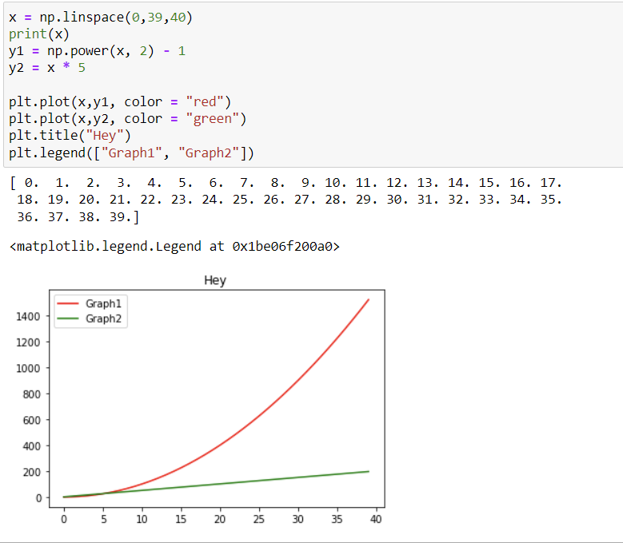
Example of plots: Regular function plots

Slide 14
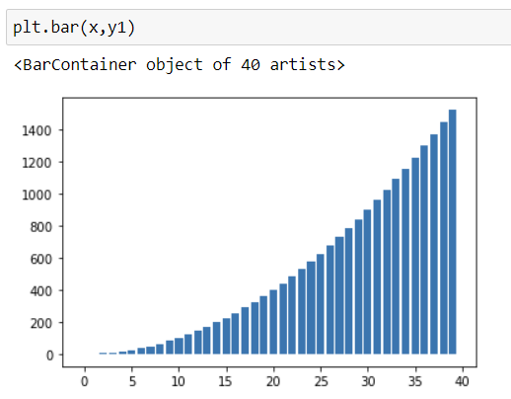
Barplots

Slide 15
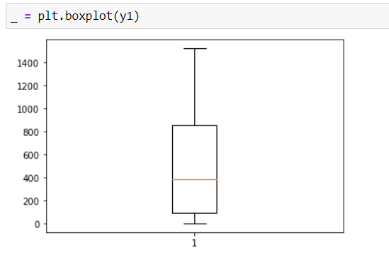
Boxplots

Slide 16
… And many many more exist!
Some worthy of mentioning are: heatmaps, histograms and scatterplots
What type of plot you want to use depends on what you want to achieve with the plot. Just plotting because of plotting is usually a bad move, you need to ensure it conveys the proper info you want to display
Avoid manipulating plots to scew results. In the world of science no one is helped by that!

Slide 17

Plotting with pandas directly
Pandas provides an interface for plotting graphs just like matplotlib (actually, it is matplotlib but a bit customized for usage with pandas dataframes!)
Whilst both can be used just fine, sometimes the pandas version might be easier and sometimes regular matplotlib might be easier

Slide 18
Python 2B
Week 5, Part 3
-
Customization options

Slide 19
More features than just legend and title
There a lot of builtin functionalities that you as the programmer can use to better visualize the data in the way you want, below are some features that might be good to know about
For example the code snippet below allows you to increase the size of your figure, it sets the dimension to 8x8 inches with each square inch representing 80 pixels

Slide 20
More options
Change linewidth, linestyle, add a grid, plot several graphs in the same output, edit colors, piecharts and much much more
The library is not huge since what the graphs and what you visualize largely depends on your data, you can think of it as the go to for rendering and working with images and figures

Slide 21
Plotting multiple graphs in the same output
A bit tricky but makes use of a grid like variable called axes retrieved as below. Axes essentially becomes a matrix of nrows, ncols dimensions where you place your figures in a slot to later on be rendered.
When matplotlib then renders the figures it renders in the order top left to bottom right going row for row

Slide 22
That’s about that for this week!
As mentioned you will be using some of these plots showcased here in the slides in this weeks assignment, although the approach might differ slightly
I highly encourage you to keep toying around and modifying the simulation if you want to look at other types of data or make it more realistic, it is a great educational experience
Best of luck and hope you have had fun with it so far!

Slide 23
Python 2B
-
Some final parting words

Slide 24
So where to go from here?
If you want to learn more about data and working with dataframes I would encourage you to learn about KNN which is an interesting ML model to predict things like quality of wine based on previous data! Very cool
Some other libraries that might be good to know about and learn of is Cython and Numba if you want to widen your toolset
Otherwise definitely get into the world of real machine learning and learn more about the concept of neural networks! (P.S keep a lookout for potential Py3b course!)

Slide 25
About Py3b
Whilst not completed nor even started currently it is in the talks but nothing decided as of now
Is a continuation of Py2b and will make use of similar tools such as numpy, anaconda and notebook
Possible topics: Machine Learning, image recognition, hand gesture prediction, statistical machine learning, Tensorflow and Pytorch

Slide 26

veldikompetens.se
Thank you!

